Slide 1


Neural Network SMS classifier

Slide 2
Introduction
SMS messages are an integral part of communication,
but spam messages can be a nuisance.
Our project aims to classify SMS messages as "spam" or "ham" (legitimate) using neural networks.
By leveraging machine learning techniques, we can automatically filter out unwanted spam messages, improving user experience and safety.

Slide 3
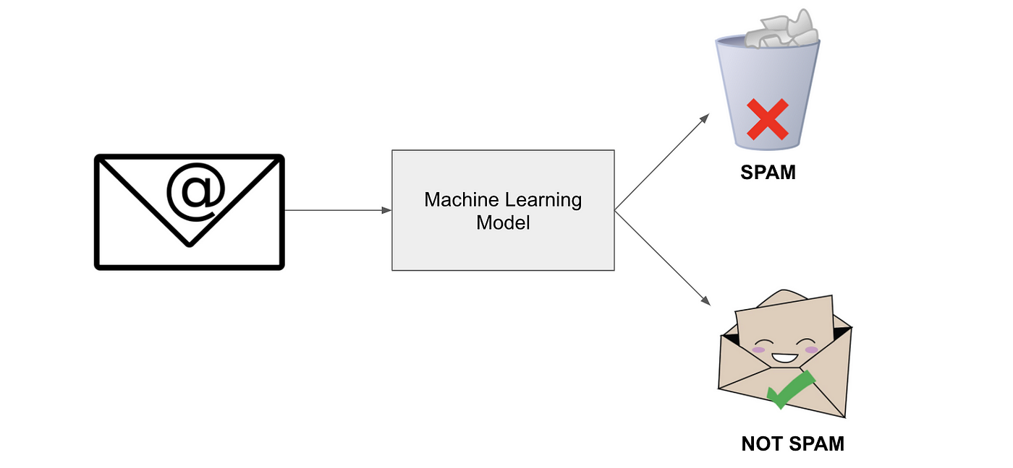
Project overview
Dataset: We utilized a dataset containing SMS messages labeled as either "ham" or "spam".
Objective: To build a neural network model that accurately classifies SMS messages.
Importance: Effective classification of SMS messages helps in spam detection and enhances user experience.

Slide 4
Data Preprocessing
Loading Data: We loaded the SMS messages dataset from CSV files.
Preprocessing Steps: Tokenization: Splitting messages into words.
Vocabulary Generation: Creating a set of unique words in the dataset.
Encoding and Padding: Integer encoding of words and padding sequences to a fixed length.

Slide 5
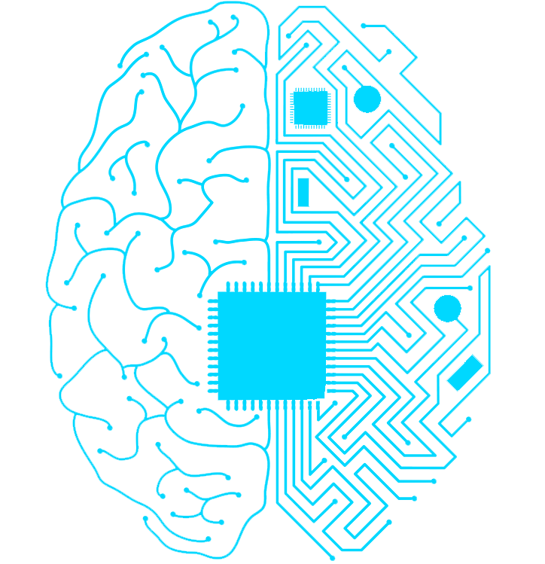
Neural Network Architecture
Embedding Layer: Converts integer-encoded words into dense vectors.
Flatten Layer: Flattens the output for the dense layer.
Dense Layer: Final output layer with sigmoid activation for binary classification.

Slide 6
Model Training
Compilation: The model is compiled with the Adam optimizer and binary cross-entropy loss.
Training Process: Early stopping is used to prevent overfitting. Training/validation split ensures model generalization.

Slide 7
Model Evaluation
Performance Metrics: Accuracy and loss metrics are evaluated.
Validation Loss Curve: Visualization of the model's performance during training.
Early Stopping Information: Details on early stopping mechanism.

Slide 8
Testing the Model
Sample Messages: Description of sample messages used for testing.
Comparison: Comparison of predicted labels with actual labels.
Result Interpretation: Discussion on the model's performance.

Slide 9
Conclusion
Our "Neural Network SMS Classifier" project effectively classifies SMS messages, enhancing user experience by filtering out spam. While successful on the provided dataset, challenges remain in generalization and scalability. Future work includes exploring different architectures and preprocessing techniques. Overall, our project demonstrates the real-world impact of machine learning in improving communication and user safety.

